Slide 1

ProBlock
A NEW STANDARD IN C90 MASONRY

Slide 2
BENEFITS
PRODUCT SUPPORT
VALUE PROPOSITION
A NEW STANDARD IN C90 MASONRY

Slide 3
BENEFITS
A NEW STANDARD IN C90 MASONRY

Slide 4
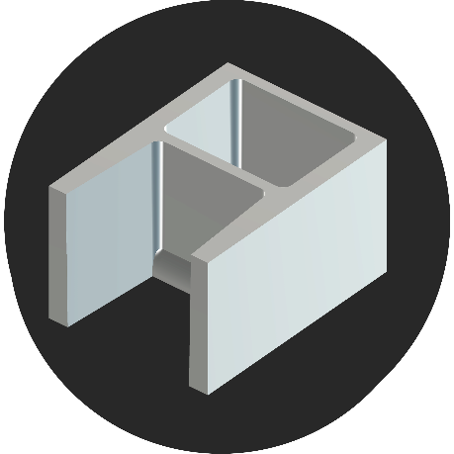
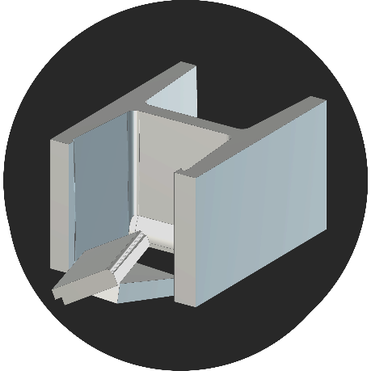
1
.
ABOUT
The ProBlock is an innovative patented concrete masonry unit benefitting owners, architects and contractors by dramatically increasing labor productivity, mason safety, and energy performance while reducing project schedules and overall project cost.
ProBlock provides newly optimized shapes and configurations, the balanced “A” block and knock-out “H” design can be produced in full and half-high units, shapes, colors and finishes.
MODIFIED “A”
KNOCKOUT “H”

Slide 5
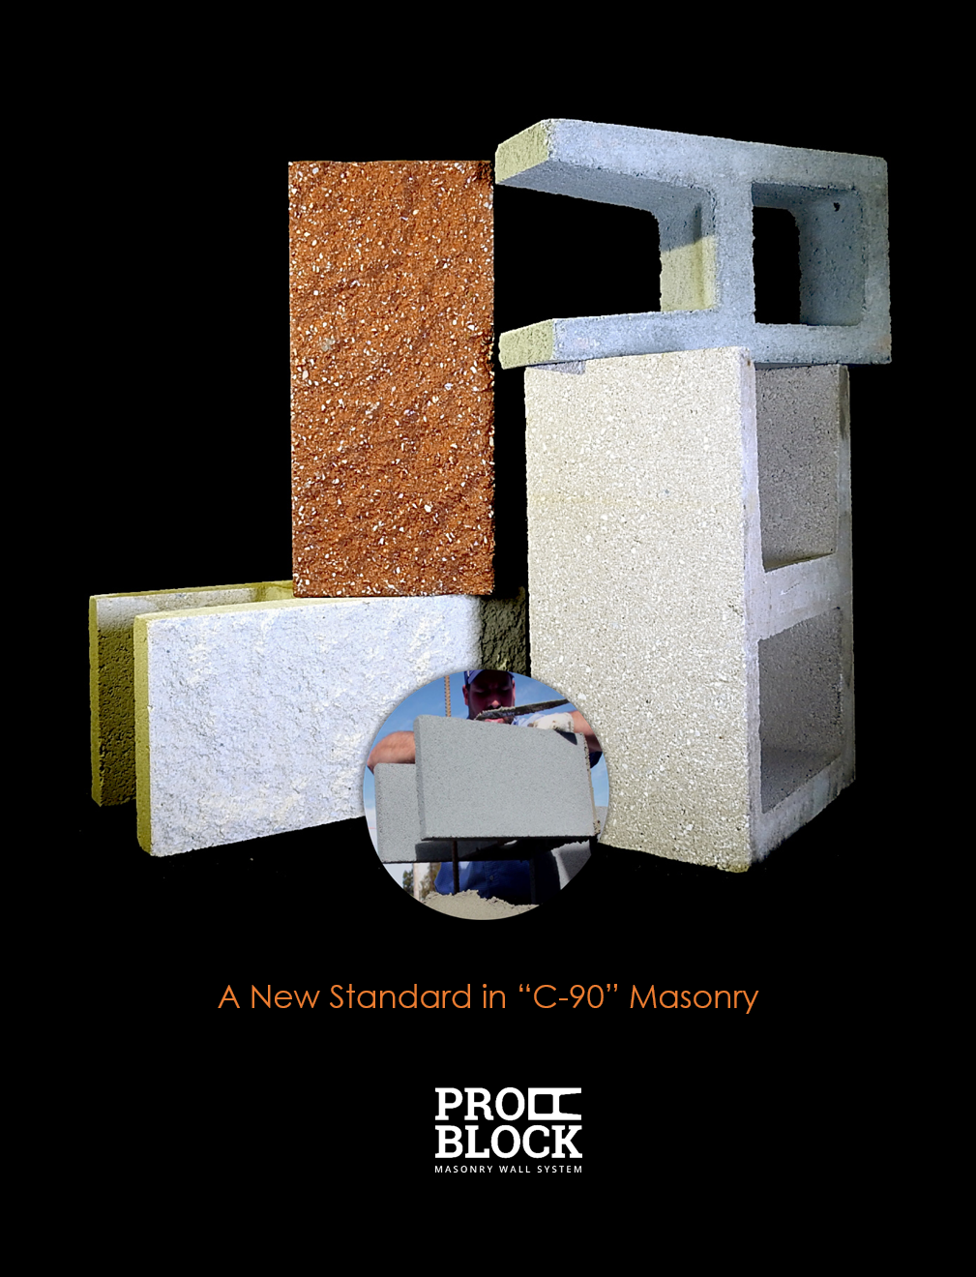
1.1
VISION
Investment generally results in acquiring an asset, also called an investment If the asset is available at a price worth investing in, it is normally expected to either generate income, or to appreciate in value.
Join the ProBlock team and invest in the next generation concrete masonry revolution. If you are interested in re-claiming markets, now is the time…

Slide 6
A Block
H Block
Typically over 1.75 inches
Typically over 2.5 inches
0.75 inches
Modified A Block

Slide 7
Key Points
Better Energy Performance
  Reduced Web Area = Better Energy Performance
  Up to 287% Higher R Value
  Can Help Meet New Energy Codes
  High Energy Performance Increase for Minimal $
  Energy Saving Over the Life of the Building
Less Load Applied to the Foundation
  Up to 52% less load associated with the self weight of masonry
Faster Completion
  Masons can lay them faster

Slide 8
Key Points
Safer job site
  Not having to lift block over rebar = lower chance of mason injury
  Fewer field cuts = lower silica exposure
  Lifting less weight = less fatigue= lower chance of mason and helper injury
More Environmentally Friendly Construction
  Less CO₂ associated with production
    Up to 30% less
  Fewer truck loads required for delivery
  Reduced job site waste
    Fewer field cuts = less waste for disposal

Slide 9


12 inch NW Block
12 inch Modified A Block
125 pcf density
85 pcf Density
Weight: 48 lbs
Web Area: 35 in²/ft²
R Value: 4.99
  Filled with R 4.6 Foam
Fire Rating: 2 hour
F’c: 2000 psi
F’m: 2000 psi
With type M or S Mortar
Weight: 22 lbs
Web Area: 14 in²/ft²
R Value: 18.14
  Filled with R 4.6 Foam
Fire Rating: 2 hour
F’c: 2000 psi
F’m: 2000 psi
With type M or S Mortar

Slide 10
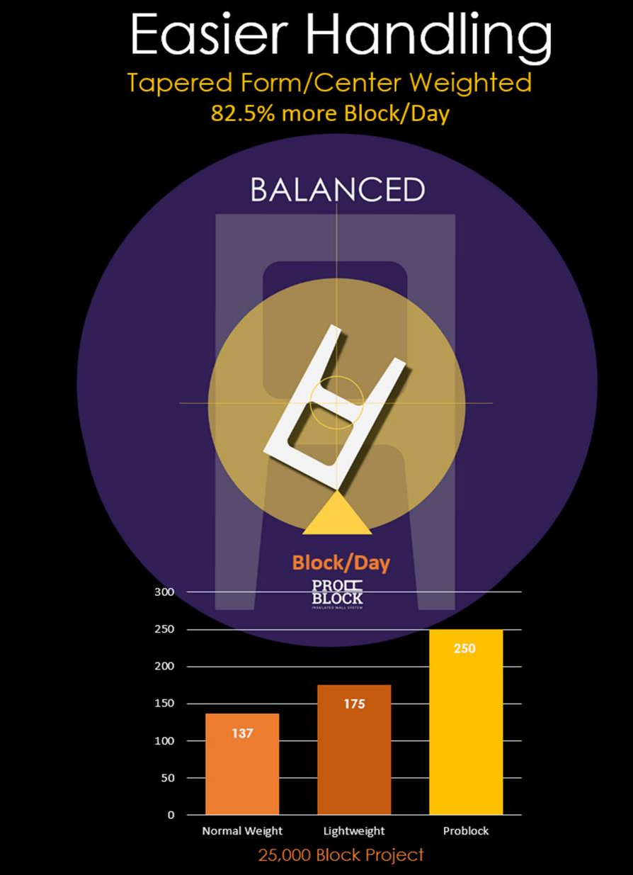
1.2
BALANCED DESIGN
ProBlock is engineered so that the center of gravity is where it should be; in the center web of the block. The finished result is a block that feels balanced in the hands of the mason.
Most open end CMU's are imbalanced and can be troublesome to handle and even contribute to injuries, given the center of gravity is not actually located at the true "center" of the mass.

Slide 11
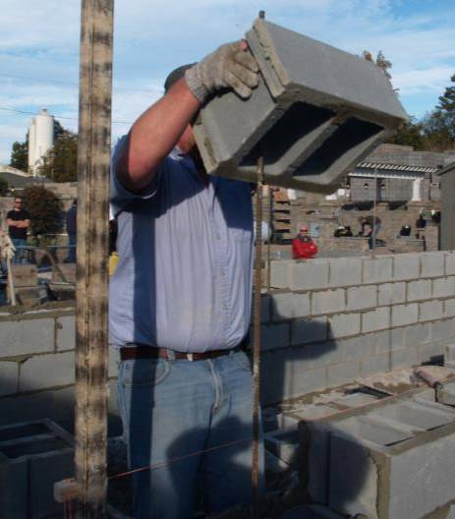



Mason Safety
How Much Weight does a mason lift ?

Slide 12

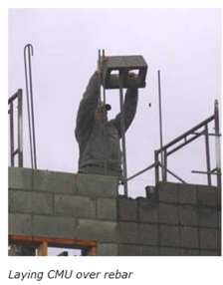
The Center for Construction Research and Training reports:
“Bricklayers have the highest rate of back injuries with lost workdays among construction workers.”
Reasons:
Block weight
Frequency of lifting materials and twisting
Height of work and materials; and
Distance of work from workers.

Slide 13
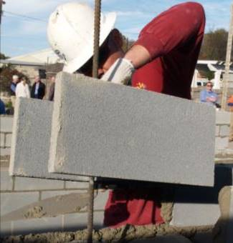
One of the two methods the Center for Construction Research and Training recommends for reducing the injuries:
1) Use open ended concrete masonry units.
An open ended concrete masonry unit (CMU) allows bricklayers to place CMU block around rebar, pipes and other vertical obstructions.

Slide 14
Recommendation #2
The use of very light concrete masonry units weighing less than 30 pounds.
Size |  | Density | Weight (Dry) | Decrease**
8x8x16 | Modified A Block | 85 pcf | 19.9 | 43%
 | Modified A Block | 105 pcf | 24.6 | 29%
 | Modified A Block 2hr Fire Rated | 85 pcf | 21.1 | 39%
 | Regular LW Block | 105 pcf | 28 | 19%
 | Regular NW Block | 130 pcf | 34.7 | 0%
12x8x16 | Modified A Block | 85 pcf | 22.5 | 54%
 | Modified A Block | 105 pcf | 27.8 | 43%
 | Regular LW Block | 105 pcf | 39.09 | 19%
 | Regular NW Block | 130 pcf | 48.4 | 0%
** Compared to Standard Normal Weight Units

Slide 15
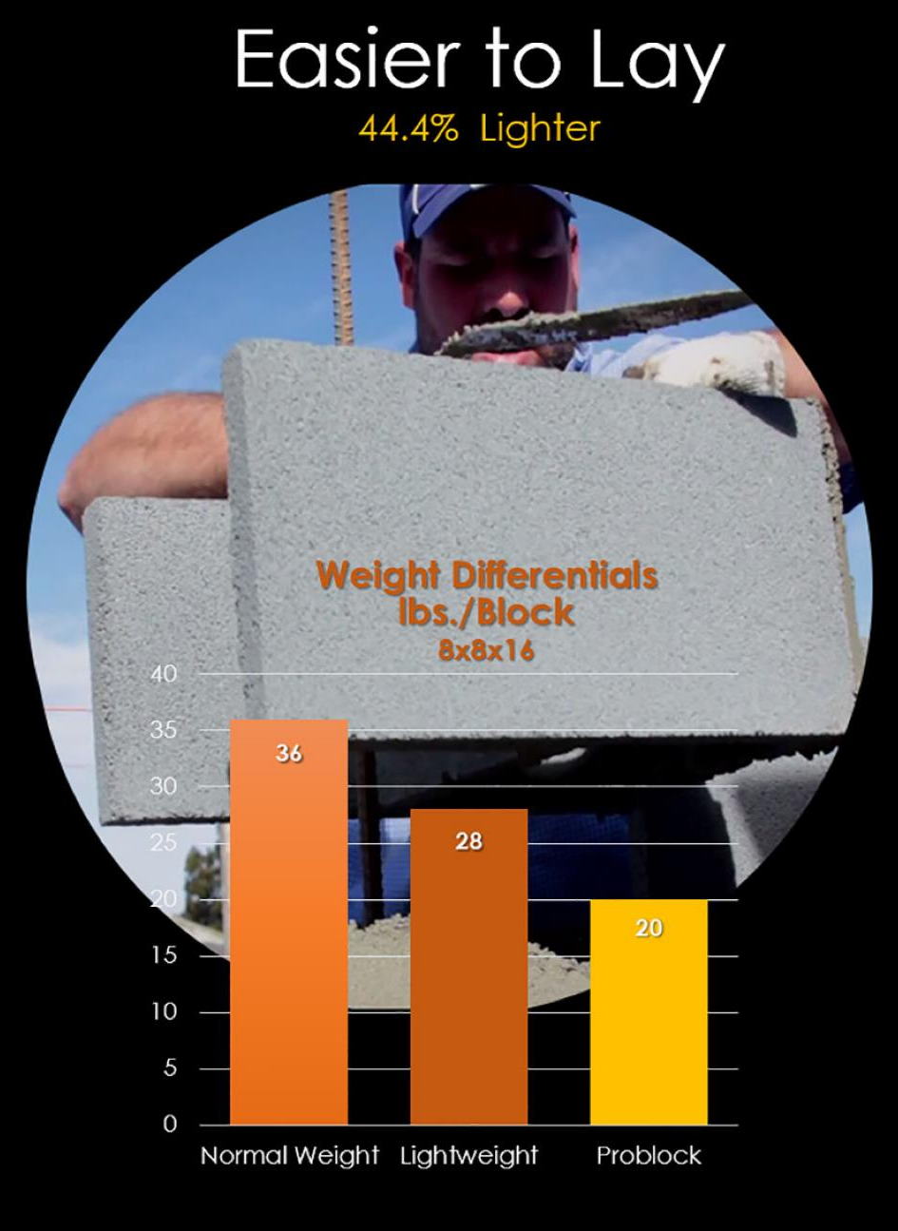
1.3
MASON FRIENDLY
Open-end design allows masons to lay around vertical rebar and utility runs and reduce/avoid overhead lifting.
Reduce rebar splicing and the amount of steel required for the project.
Reduce Silica exposure by limiting the need to cut units

Slide 16
Foundation Load Reduction
12 inch block
20' X 200' wall example
Grout Spacing | Block Type | Weight/ LF | Decrease
Ungrouted | Modified A Block | 558 | 52%
 | Standard | 1168
16 X 48 | Modified A Block | 1805 | 18%
 | Standard | 2197
32 X 48 | Modified A Block | 1312 | 28%
 | Standard | 1813
48 X 48 | Modified A Block | 1148 | 32%
 | Standard | 1685
48 X 72 | Modified A Block | 961 | 37%
 | Standard | 1516
72 X 72 | Modified A Block | 934 | 38%
 | Standard | 1495

Slide 17
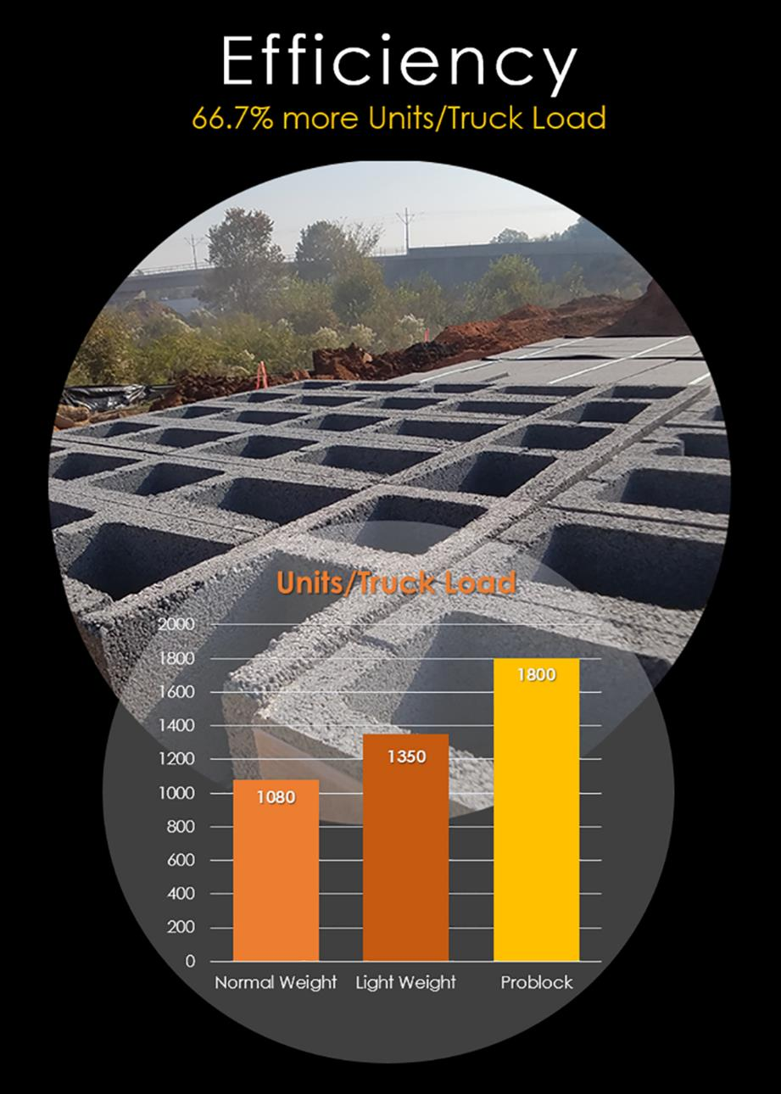
1.4
LOGISTICS
Material savings and lighter weights translates into freight savings allowing for up to 42% more PB units per truck load, and more block per pallet.

Slide 18
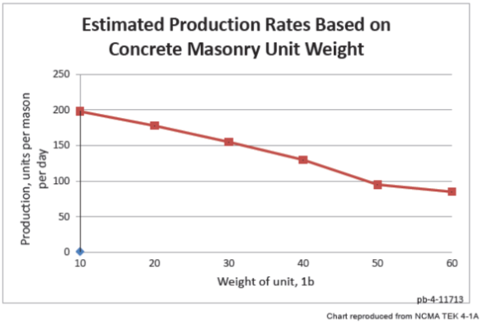
12 inch NW Block
12 inch Modified A Block
Estimated blocks per mason per day from NCMA estimate : 100
Estimated blocks per mason per day from NCMA estimate : 165
65% INCREASE
125 pcf density
85 pcf Density

Slide 19
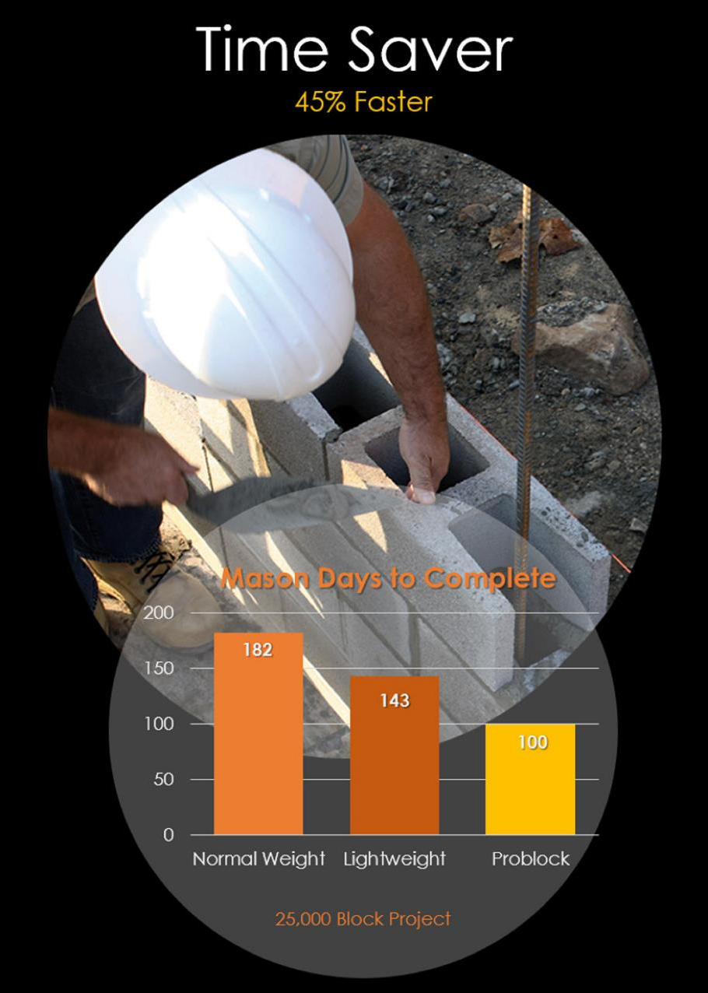
1.5
SPEED of CONSTRUCTION
With ProBlock’s open-end design, masons can more efficiently, easily, and with less effort, lay up a wall in record time.
Walls can be planned to include longer lengths of vertical rebar reducing the amounts of rebar splicing and the total amount of required steel.

Slide 20
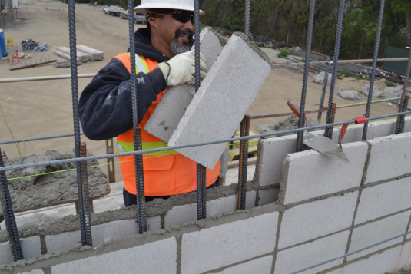
Benefits
Faster, cheaper, simpler, more energy efficient, more ‘groutable’ – complete system.

Slide 21
Mason Productivity
Actual production numbers from a masonry contractor using the 12 inch Modified A Block on a project in Charlotte, NC.
 | 12 inch Blocks Laid | # Masons | Hours worked | Actual Blocks/mason/day | Estimated for Job by Mason | # block Increase | % Increase | NCMA Estimated Production (NW) | # block increase | % increase
Start-up | 1344 | 6 | 8 | 224 | 170 | 54 | 32% | 100 | 124 | 124%
Straight Wall | 1410 | 5 | 8 | 282 | 170 | 112 | 66% | 100 | 182 | 182%
One of the masons on the straight wall laid over 300 12 inch block in 8 hours with plumbing in several locations.

Slide 22
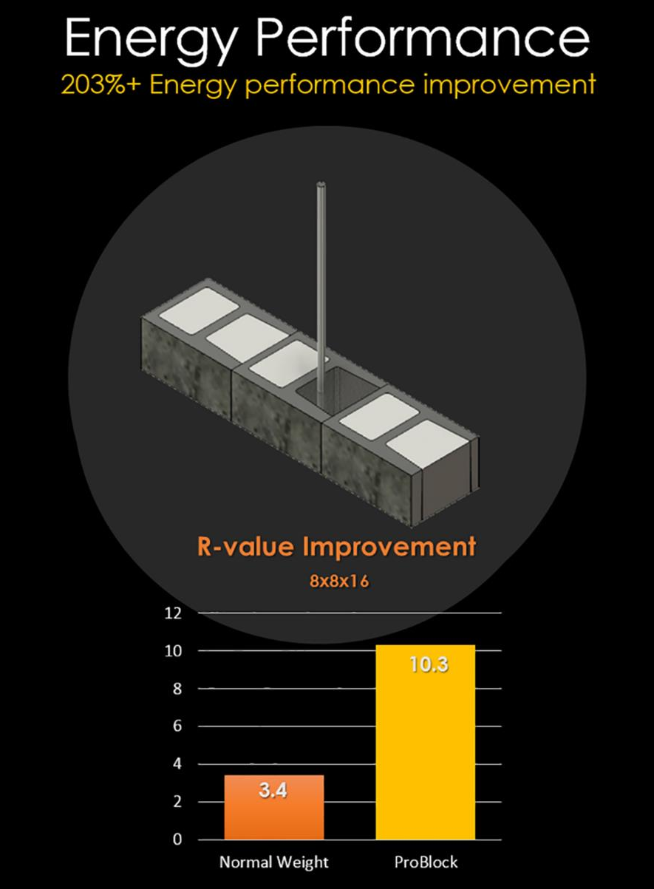
1.6
ENERGY SAVINGS
ProBlock wall systems are the most cost effective way to achieve energy performance objectives on a project.
ProBlock enables the single wythe wall system to more easily comply with energy code

Slide 23
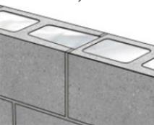
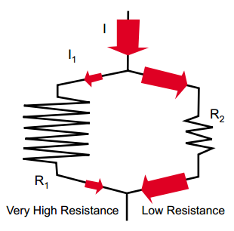
Energy Performance
The key to maximizing the R value of concrete masonry is:
Minimizing the thermal bridges within the masonry and
Increasing the thermal resistance of the materials used to produce the concrete masonry unit.

Slide 24
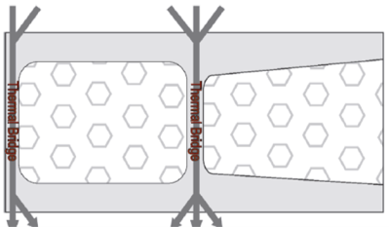
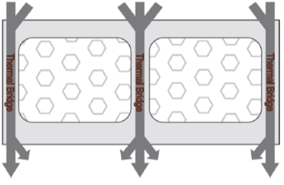
A thermal bridge allows heat to “short circuit” insulation.
In concrete masonry the webs act as Thermal Bridges

Slide 25
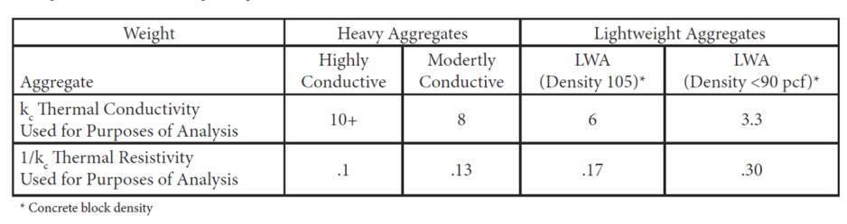
ESCS lightweight aggregate has a density of about half that of typical normal weight aggregates
Concrete made with lightweight aggregate has a thermal resistivity up to 3 times higher.

Slide 26
Modified A Block
Half the web area + lightweight aggregate=
Less thermal bridging
Higher R values
Energy Savings

Slide 27
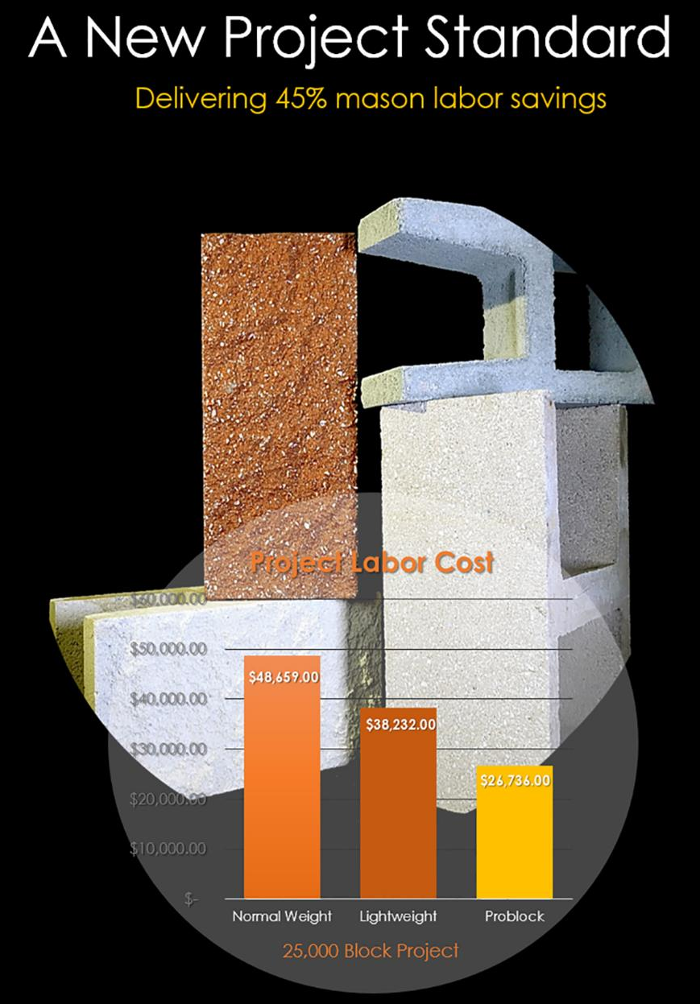
1.7
COST SAVINGS
The physical demands of block laying is not new. Since the early 1900's, the design of a concrete masonry unit has not changed.
Now, the innovative ProBlock allows the producer to optimize production and delivery of product and the mason to install concrete masonry units in the most productive and safest way possible.

Slide 28
Key Points
Safer job site
  Not having to lift block over rebar = lower chance of mason injury
  Fewer field cuts = lower silica exposure
  Lifting less weight = less fatigue= lower chance of mason and helper injury
More Environmentally Friendly Construction
  Less CO₂ associated with production
    Up to 30% less
  Fewer truck loads required for delivery
  Reduced job site waste
    Fewer field cuts = less waste for disposal

Slide 29
CO₂ Reduction
Modified A Block |  | Cement Reduction% | Approx. CO2 Reduction PSF of Wall Area
8x8x16 | Modified A Block | 19% | 0.69
 | Fire Rated Modified A Block | 9% | 0.33
 | Regular NW Block
12x8x16 | Modified A Block | 33% | 1.20
 | Fire Rated Modified A Block | 22% | 0.80
 | Regular NW Block

Slide 30

Fewer Trucks Required for Delivery
 | Typical 12 in NW | Modified A Block 12 In LW
Block Weight | 50 | 26
Total Blocks to be Delivered | 25000 | 25000
Blocks/Cube | 72 | 72
# Cubes | 348 | 348
Weight/Cube | 3620 | 1892
40”X48” Cubes/Truck Max | 20 | 20
Maximum Wt/Load | 40000 | 40000
Cubes/Truck (40,000 lb load) | 11 | 20
Blocks/ 40,000 lb Load | 792 | 1440
Number Loads Required | 32 | 18
Truck Load Reduction | 14
% Load Reduction | 44%
miles | 30 | 30
per load | $ 130 | $ 130
trucking | $ 4,160 | $ 2,340
$ Transportation Savings | $ 1,820

Slide 31
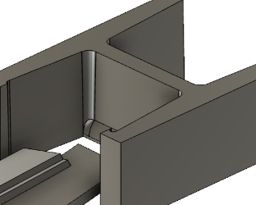
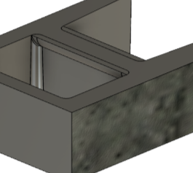
What is available
8, 10 and 12 inch Modified A Block units
  Lightweight Gray Block
  Architectural Custom Colored
  -Smooth Face
  -Ground/Polished
  Modified A Block Types Coming Soon

Slide 32
3. Business Case
THE PROBLOCK VALUE PROPOSITION

Slide 33
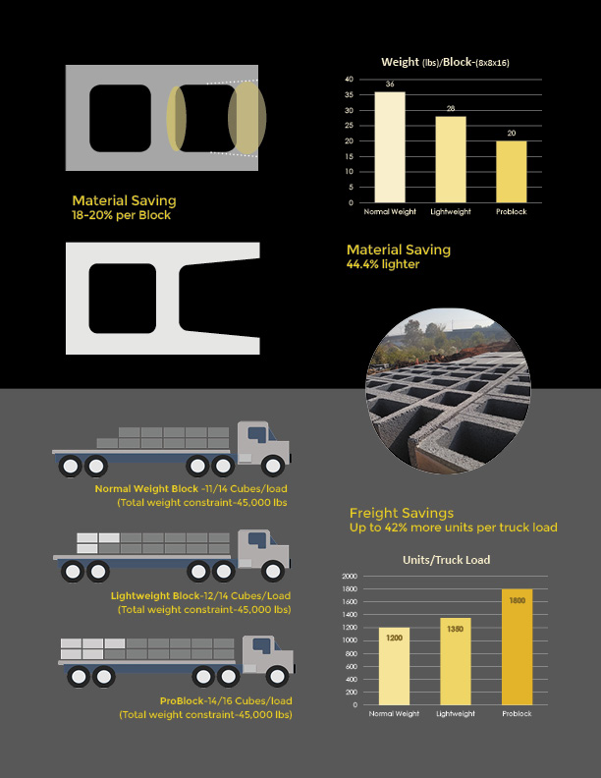
3.1
BUSINESS CASE
The business case for ProBlock is built on a number of key factors including, material savings and physical weight reductions that help the producer realize savings in both materials and freight costs.

Slide 34
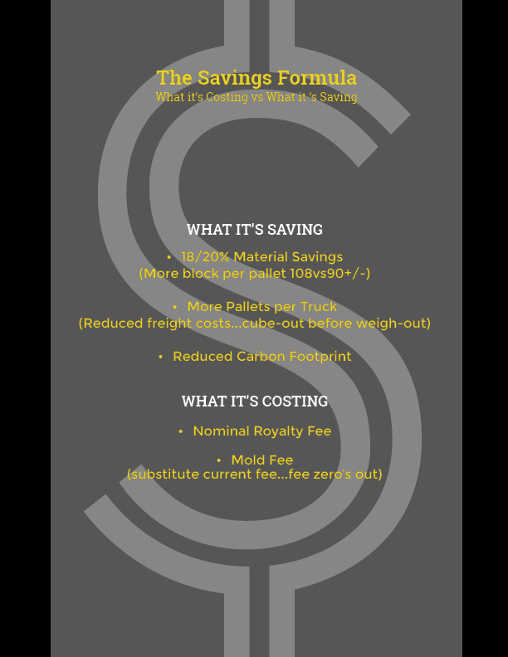
3.2
VALUE PROPOSITION
Production trade-off costs combined with on-site support, saving in material costs and environmental benefits contribute to the ProBlock value proposition.

Slide 35


